Slide 1
PAP titration in the sleep center basics and challenges
Musab Nusrat , MD.
Pulmonary Critical Care and Sleep Medicine
Prevea Health
GreenBay WI

Slide 2
Obstructive sleep apnea (OSA) is a disorder characterized by apneas and hypopneas due to repetitive collapse of the upper airway during sleep.
After a patient is diagnosed with OSA, the current standard of practice involves performing an attended polysomnography (PSG), during which positive airway pressure is adjusted throughout the recording period to determine the optimal pressure for maintaining upper airway patency
The initiation of PAP therapy requires selection of a mode of PAP (e.g., continuous or bilevel PAP) and titration of pressure to reduce and/or eliminate obstructive events to an acceptable level during sleep.

Slide 3
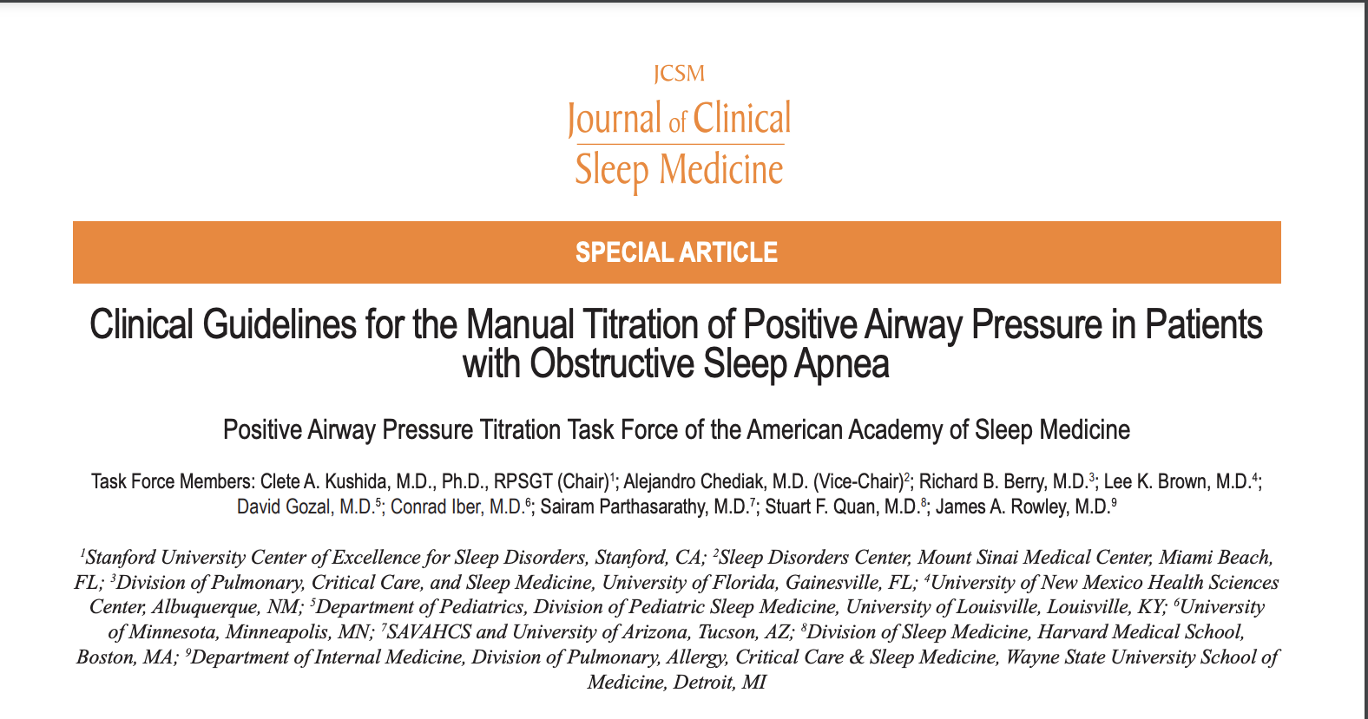
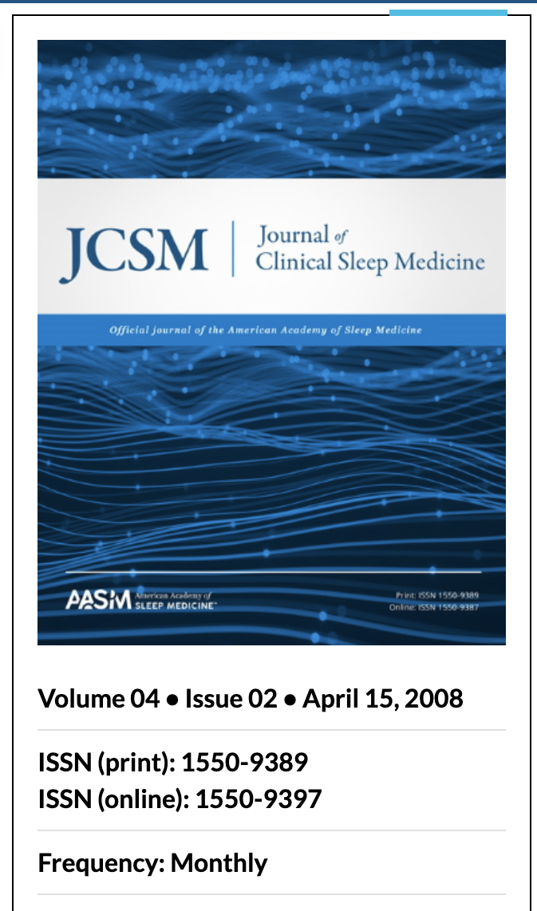

Slide 4
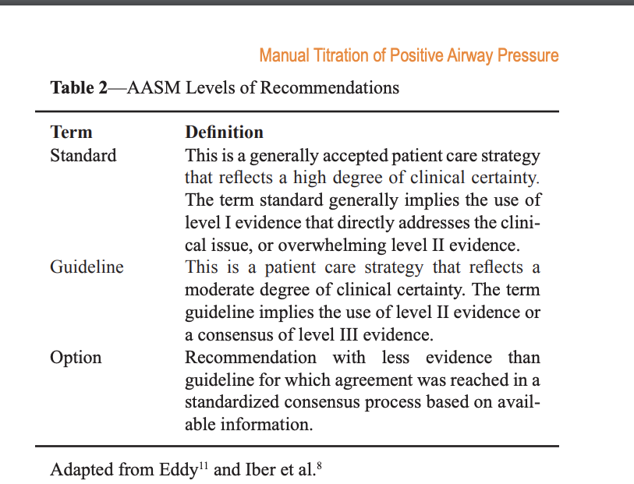
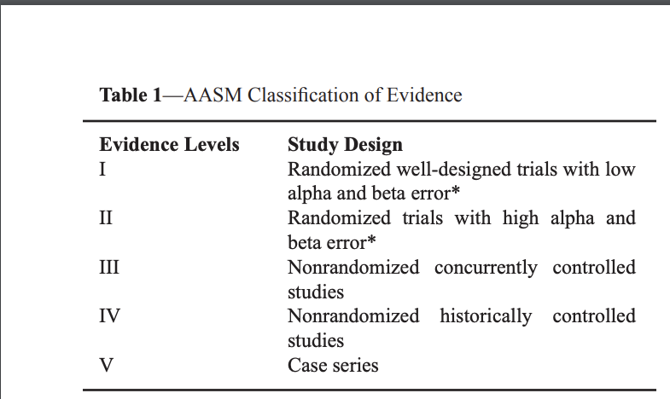
AASM levels of recommendations (Table 2) are indicated in parentheses after recommendations that are based on published practice parameters;
Those recommendations that were not based on published parameters are labeled as “(Consensus).”

Slide 5
There are two major PAP modalities that are manually titrated to treat patients with OSA ( that is not complicated by central sleep apnea (CSA), other respiratory dysrhythmias, or hypoventilation) ;
- CPAP.
- BiPAP-S.
There are also more technologically advanced PAP devices designed for specific applications (complicated sleep apnea)
- BPAP in spontaneous/timed mode or timed mode (BPAP-S/T and BPAP-T)
- Adaptive servo-ventilation (ASV).
- Volume-assured pressure support (VAPS).

Slide 6
TITRATION GOALS:
The goal of any titration is to determine the minimal pressure(s) required to resolve all apneas, hypopneas, snoring, and arousals related to obstructive events, in all stages of sleep and in all sleep positions.

Slide 7
TITRATION GOALS:
The goal of any titration is to determine the minimal pressure(s) required to resolve all apneas, hypopneas, snoring, and arousals related to obstructive events, in all stages of sleep and in all sleep positions.

Slide 8
PAP Titration Task Force and the AASM Board of Directors recommendations for in Lab PAP titration.
(restricted to adult (≥12 years) and pediatric (<12 years)
The recommended minimum starting CPAP should be 4 cm H2 O for pediatric and adult patients (Consensus).
CPAP should be increased until the following obstructive respiratory events are eliminated (no specific order) : apneas, hypopneas, RERAs, and snoring or the recommended maximum CPAP is reached (Consensus).
The recommended maximum CPAP should be 15 cm H2 O for patients <12 years and 20 cm H2 O for patients ≥12 years (Consensus)

Slide 9
CPAP should be increased by at least 1 cm H2O with an interval no shorter than 5 min, with the goal of eliminating obstructive respiratory events (Consensus).
CPAP should be increased if at least 1 obstructive apnea is observed for patients <12 years or if at least 2 obstructive apneas are observed for patients ≥12 years (Consensus).
CPAP should be increased if at least 1 hypopnea is observed for patients <12 years or if at least 3 hypopneas are observed for patients ≥12 years (Consensus).
CPAP should be increased if at least 3 RERAs are observed for patients <12 years or if at least 5 RERAs are observed for patients ≥12 years (Consensus).
CPAP may be increased if at least 1 min of loud or unambiguous snoring is observed for patients <12 years or if at least 3 min of loud or unambiguous snoring are observed for patients ≥12 years (Consensus).

Slide 10
“ Exploration” of CPAP above the pressure at which control of abnormalities in respiratory parameters is achieved should not exceed 5 cm H2 O (Consensus).
If the patient awakens and complains that the pressure is too high, the pressure should be restarted at a lower pressure, chosen as one that the patient reports is comfortable enough to allow return to sleep (Consensus).
“Down” titration is not required but may be considered as an option (Consensus).
The titration algorithm for split-night CPAP titration studies should be identical to that of full-night CPAP titration studies (Guideline).

Slide 11
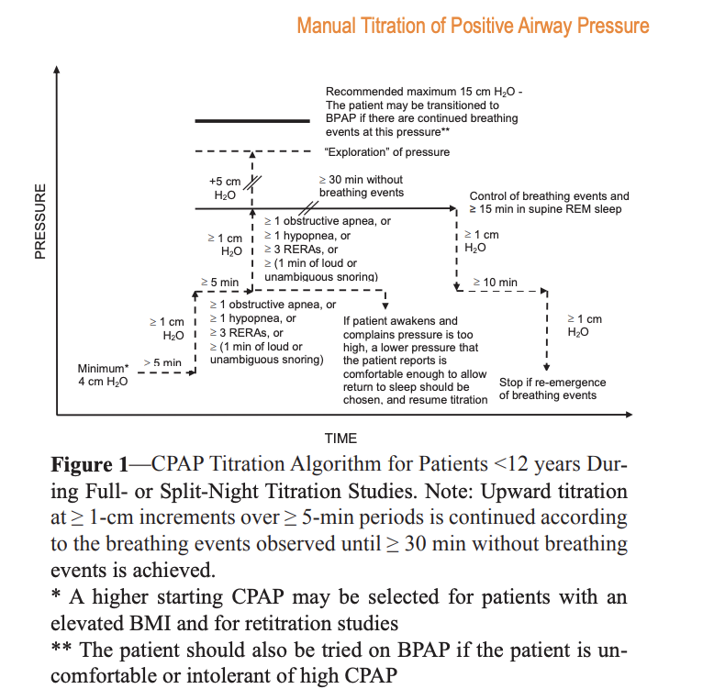
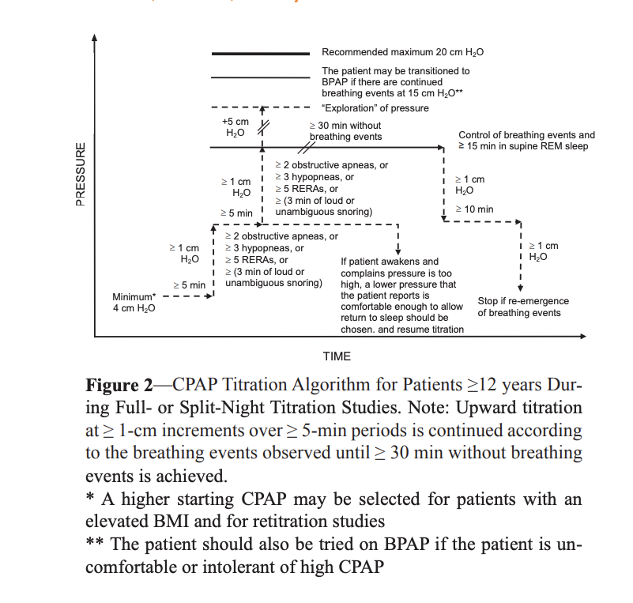

Slide 12
Recommendations for Conducting Bilevel PAP (BPAP) Titration Studies in Pediatric or Adult Patients with Obstructive Sleep Apnea:
If the patient is uncomfortable or intolerant of high pressures on CPAP, the patient may be tried on BPAP.
If there are continued obstructive respiratory events at 15 cm H2 O of CPAP during the titration study, the patient may be switched to BPAP (Consensus).
BPAP (IPAP and/or EPAP, depending on the type of obstructive respiratory event) should be increased until the following events are eliminated (no specific order) or the recommended maximum IPAP is reached: apneas, hypopneas, RERAs, and snoring (Consensus).

Slide 13
Recommendations for Conducting Bilevel PAP (BPAP) Titration Studies in Pediatric or Adult Patients with Obstructive Sleep Apnea:
The recommended minimum starting IPAP and EPAP should be 8 cm H2 O and 4 cm H2 O, respectively, in pediatric and adult patients (Consensus).
The recommended maximum IPAP should be 20 cm H2 O for patients <12 years or 30 cm H2 O for patients ≥12 years (Consensus).
Methodology to determine IPAP or EPAP a priori has insufficient evidence, although a higher starting IPAP or EPAP may be selected for patients with an elevated BMI and for re-titration studies (Consensus).
The recommended minimum IPAP-EPAP differential is 4 cm H2 O and the recommended maximum IPAP-EPAP differential is 10 cm H2 O (Consensus).

Slide 14
IPAP and/or EPAP should be increased by at least 1 cm H2 O apiece with an interval no shorter than 5 min, with the goal of eliminating obstructive respiratory events (Consensus).
IPAP and EPAP should be increased if at least 1 obstructive apnea is observed for patients <12 years or if at least 2 obstructive apneas are observed for patients ≥12 years (Consensus).
IPAP should be increased if at least 1 hypopnea is observed for patients <12 years or if at least 3 hypopneas are observed for patients ≥12 years (Consensus).
IPAP should be increased if at least 3 RERAs are observed for patients <12 years or if at least 5 RERAs are observed for patients ≥12 years (Consensus).
IPAP may be increased if at least 1 min of loud or unambiguous snoring is observed for patients <12 years or if at least 3 min of loud or unambiguous snoring are observed for patients ≥12 years (Consensus).

Slide 15
“Exploration” of IPAP above the pressure at which control of abnormalities in respiratory parameters is achieved should not exceed 5 cm H2 O (Consensus)
If the patient awakens and complains that the pressure is too high, the pressure should be restarted at a lower IPAP, chosen as one that the patient reports is comfortable enough to allow return to sleep (Consensus).
A decrease in IPAP or setting BPAP in spontaneous-timed (ST) mode with backup rate may be helpful if treatment-emergent central apneas (i.e., complex sleep apnea) are observed during the titration study (Consensus)
“Down” titration is not required but may be considered as an option (Consensus)

Slide 16
The titration algorithm for split-night BPAP titration studies should be identical to that of full-night BPAP titration studies (Consensus).
It may be prudent to increase IPAP and EPAP at larger increments (i.e., 2 or 2.5 cm H2 O) given the shorter BPAP titration duration in split-night vs. full-night studies.
Of note, there are insufficient data to make any recommendations for split-night BPAP titration studies in children <12 years.

Slide 17
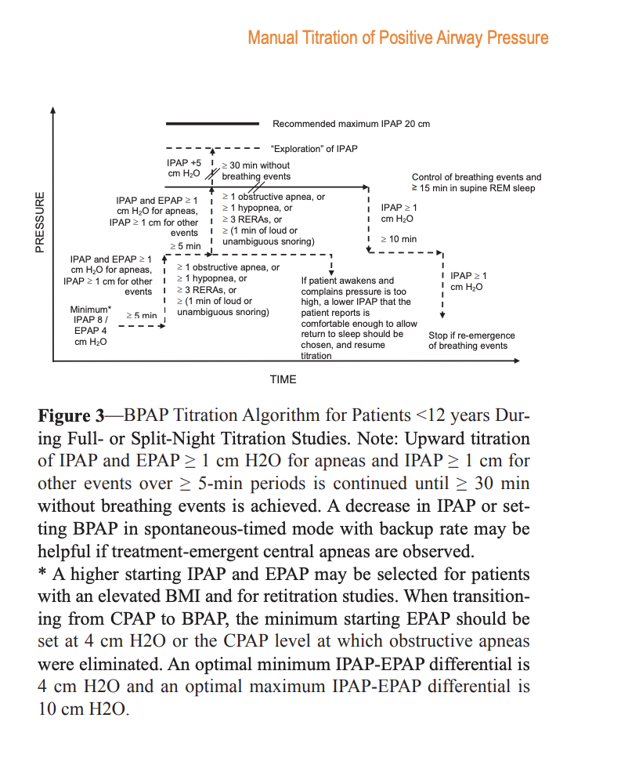
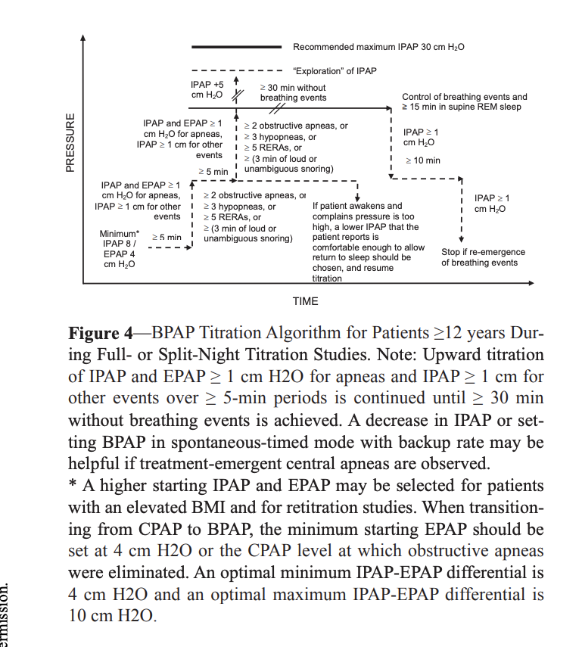

Slide 18
Acceptable PAP Titration Study ;
The CPAP or BPAP selected for patient use following the titration study , should reflect control of the patient’s obstructive respiration by :
A low (preferably <5 per hour) RDI at the selected pressure.
A minimum sea level SpO2 above 90% at the pressure.
A leak within acceptable parameters at the pressure (Consensus).

Slide 19
Acceptable PAP Titration Study ;
Grading system:
An optimal titration reduces RDI <5 per hour for at least a 15-min duration and should include supine REM sleep at the selected pressure that is not continually interrupted by spontaneous arousals or awakenings (Consensus).
A good titration reduces the overnight RDI ≤10 per hour or by 50% if the baseline RDI <15 per hour and should include supine REM sleep that is not continually interrupted by spontaneous arousals or awakenings at the selected pressure (Consensus).
An adequate titration is one that does not reduce the overnight RDI ≤10 per hour but does reduce the RDI by 75% from baseline (especially in severe OSA patients), or one in which the titration grading criteria for optimal or good are met with the exception that supine REM sleep did not occur at the selected pressure (Consensus).

Slide 20
An unacceptable titration is one that does not meet any one of the above grades (Consensus).
A repeat PAP titration study should be considered if the initial titration does not achieve a grade of optimal or good and, if it is a split-night PSG study, it fails to meet AASM criteria (Consensus).
PAP mask refit or readjustment should be performed whenever any significant unintentional leak is observed (Consensus).

Slide 21
Challenges during the PAP titration

Slide 22
Insomnia during the PAP titration :
? Hypnotics :

Slide 23
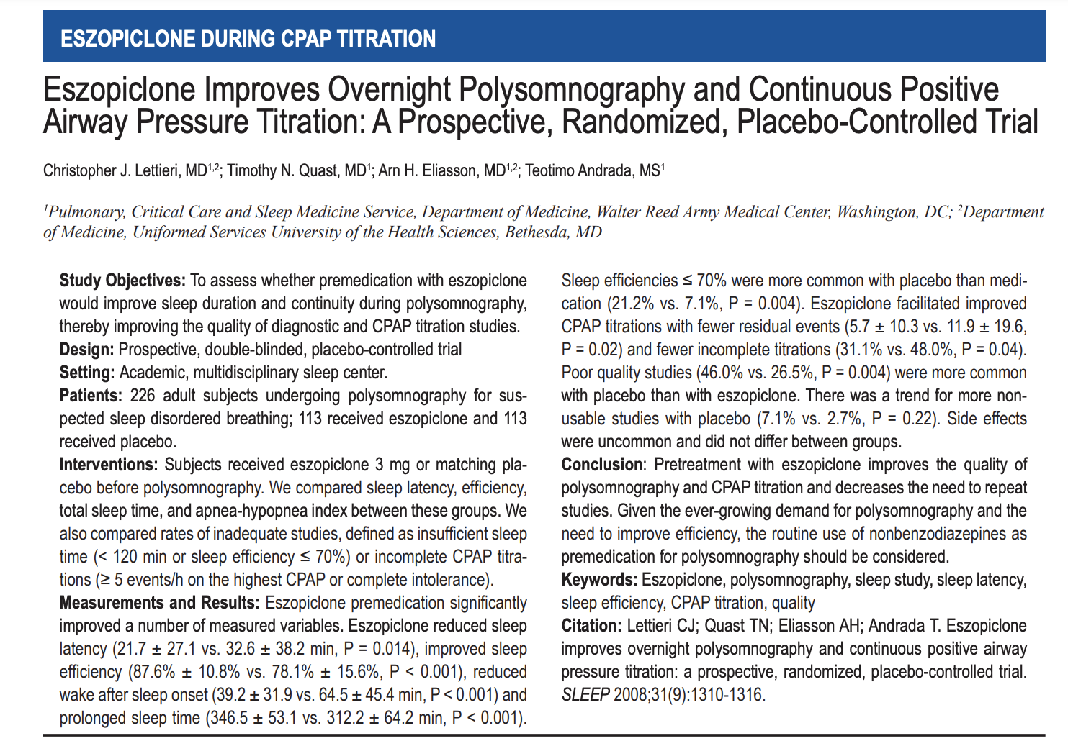
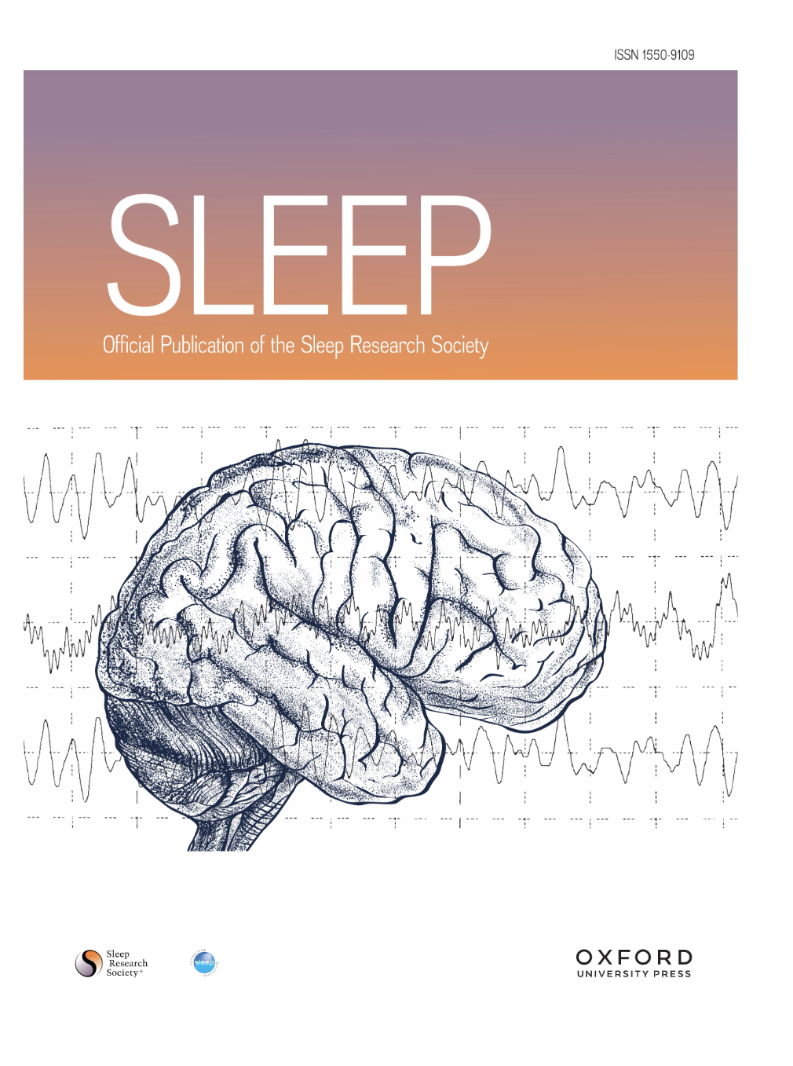
1) Insomnia during the PAP titration :

Slide 24
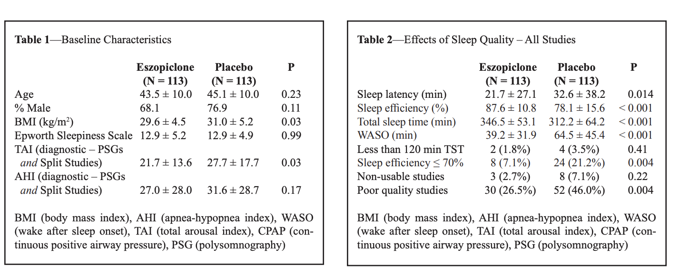
1) Insomnia during the PAP titration :

Slide 25
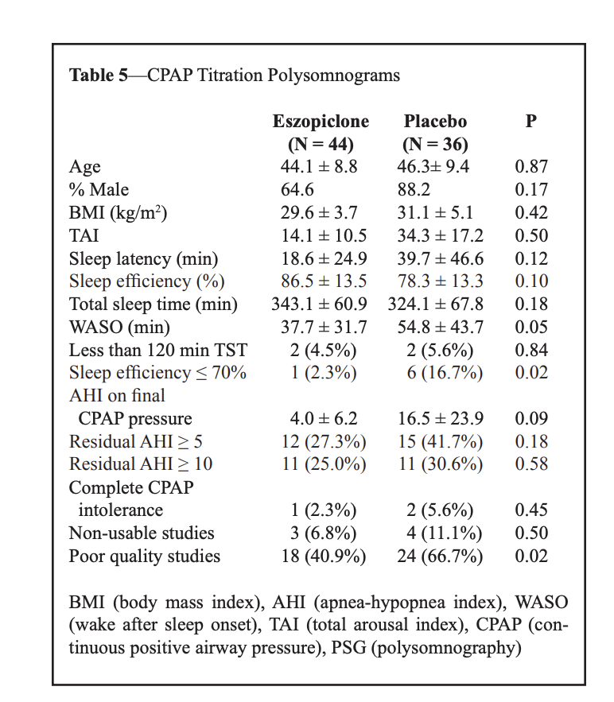
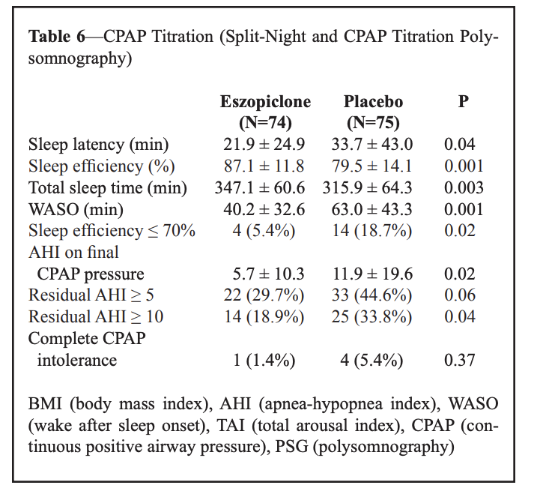

Slide 26
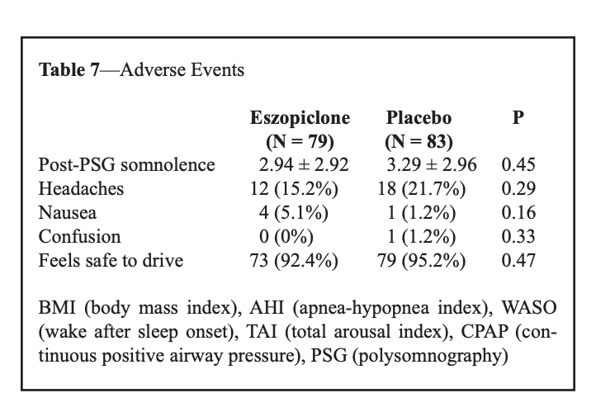
Conclusion:
Pretreatment with eszopiclone improves the quality of polysomnography and CPAP titration and decreases the need to repeat studies.

Slide 27
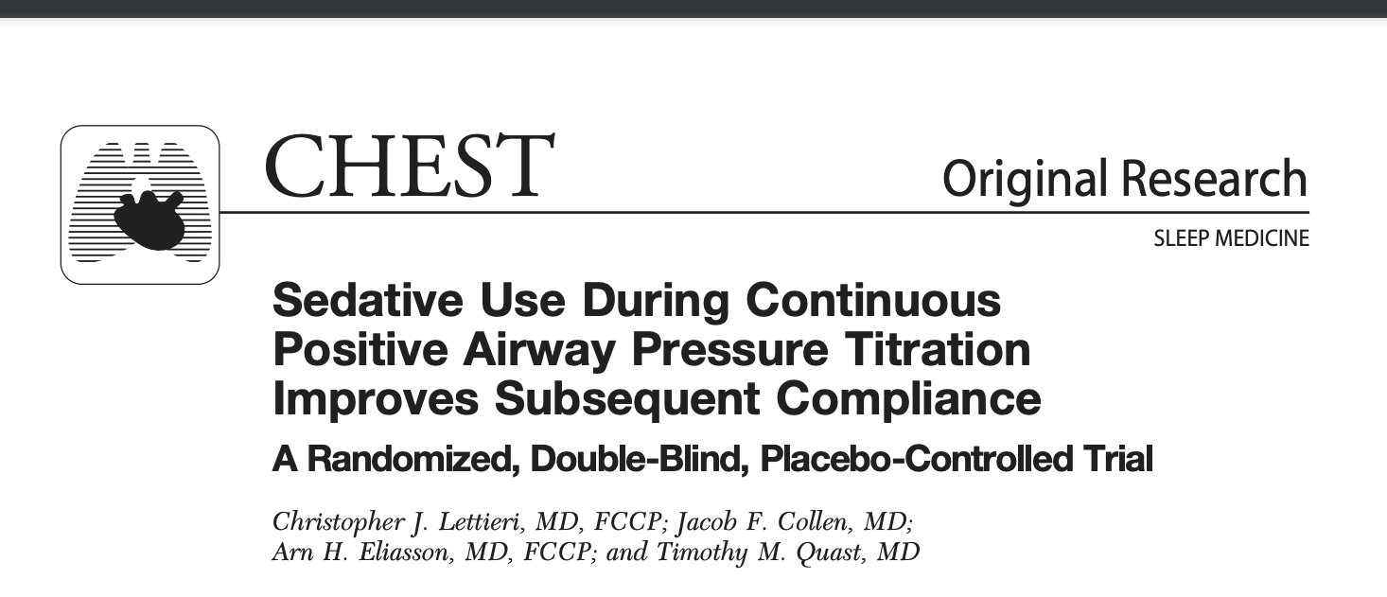
Results:
117 subjects, and 98 subjects completed the protocol (eszopiclone, 50 subjects; placebo, 48 subjects).
Other than there being more women in the eszopiclone group, the groups were similar at baseline.
Compared with placebo, premedication with eszopiclone significantly improved mean ( SD) sleep efficiency (87.8 5.8% vs 80.1 10.5%, respectively; p 0.002) and mean total sleep time (350.9 33.6 min vs 319.7 48.7 min, respectively; p 0.007).
A trend toward improved sleep latency (19.4 16.1 min vs 31.8 30.4 min, respectively; p 0.08) and the number of residual obstructive events observed at the final CPAP pressure (6.4 7 events/h vs 12.8 14.6 events/h, respectively; p 0.08) during polysomnography was found.
Eszopiclone significantly improved CPAP compliance. (75.9 20.0% vs 60.1 24.3%,; p 0.005) and for more hours per night (4.8 1.5 h vs 3.9 1.8 h,p 0.03).
(CHEST 2009; 136:1263–1268)

Slide 28
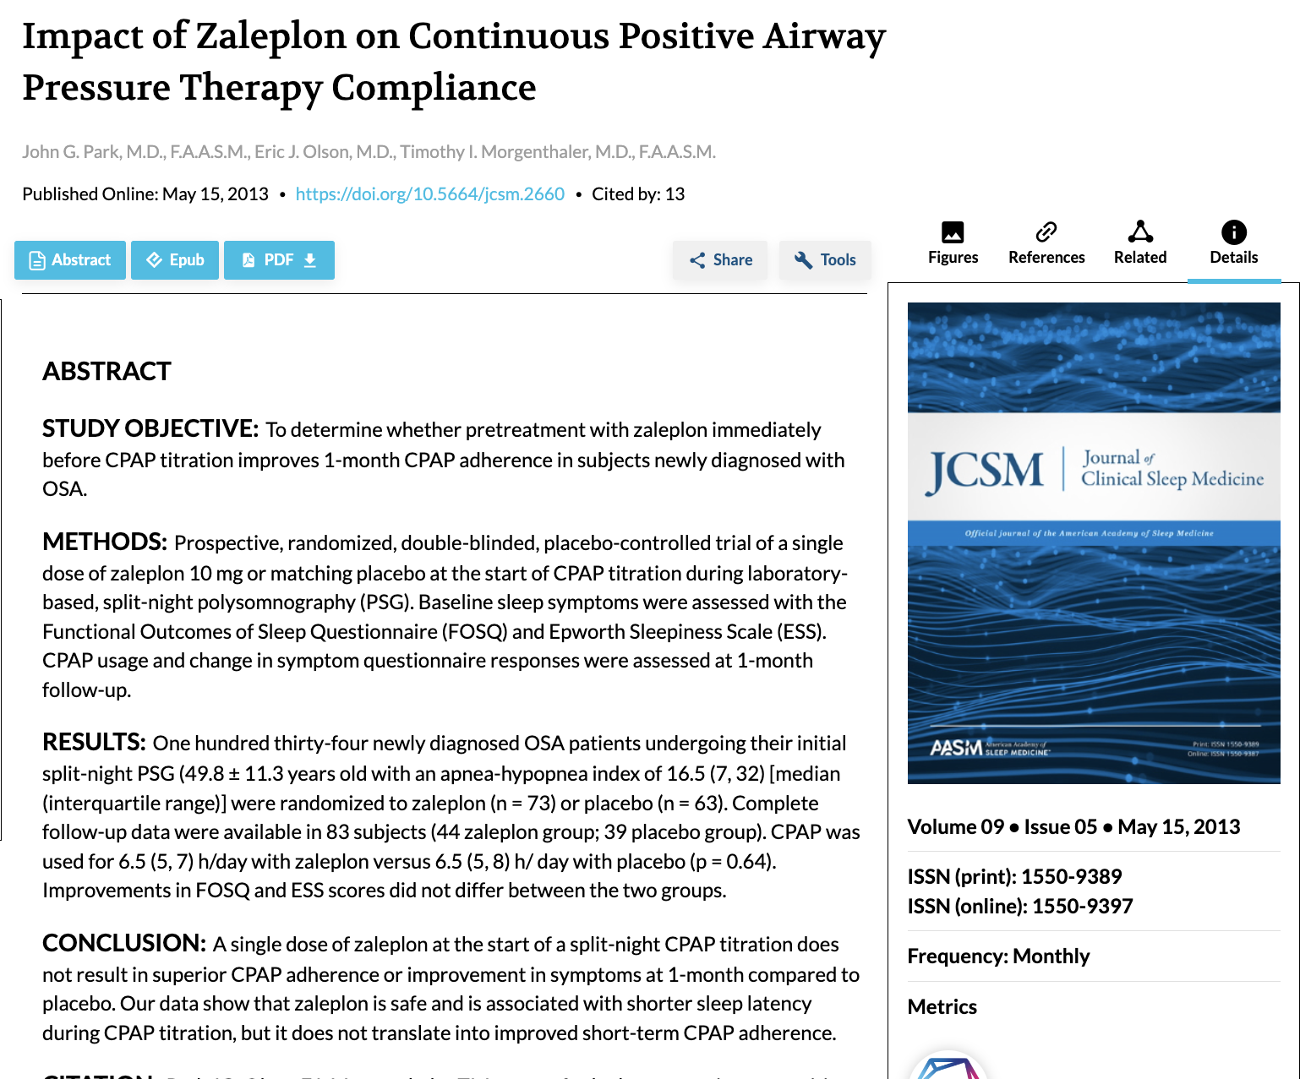

Slide 29
# 2) Leakage :
Leakage forms:
Intentional leak is the controlled leak from the port on mask interfaces that washes out CO2 and prevents rebreathing.
Unintentional leak : - Mouth leak (i.e., pressurized air escaping via the mouth when a nasal mask is used) - Mask leak : (i.e., pressurized air escaping between the mask and the face when a nasal mask or full-face/oronasal mask is used).
R:
- Chinstrap ( Mouth leak ).
- Mask refit or readjustment ( mask leak).
- A study examining the effects of mask leak on the efficacy of BPAP therapy reported that the patients showed improved oxygenation, decreased arousal index, and increased REM sleep when this leak was minimized

Slide 30
# 3) Hypoxia:
Supplemental Oxygen :
Supplemental O2 should be added during the PAP titration when, prior to the PAP titration, the patient’s awake supine SpO2 while breathing room air is ≤88%.
Supplemental O2 may also be added during the PAP titration when SpO2 is ≤88% for ≥5 minutes in the absence of obstructive respiratory events.
In both instances, supplemental O2 should be introduced at 1 L/min and titrated upwards to achieve a target SpO2 between 88% and 94% (Consensus).
O2 rate should be increased by 1 L/min, with an interval no shorter than 15 min, until SpO2 is between 88% and 94%

Slide 31
# 4) Treatment emergent central sleep apnea
Treatment-emergent central sleep apnea (TE-CSA), previously referred to as complex sleep apnea, is detected in approximately 5 to 15 % of patients who undergo positive airway pressure (PAP) titration for obstructive sleep apnea (OSA).
In more than 50% of the TE- CSA is a transient phenomenon that resolves within the first few months of PAP.
Less commonly, the abnormality is persistent and requires a change in mode of ventilation.

Slide 32
● Male sex .
● Older age .
● Comorbid heart failure or coronary artery disease.
● Severe obstructive sleep apnea (OSA) .
● Presence of a mixture of obstructive, mixed, and central apneas during initial polysomnography .
● Higher arousal index on baseline polysomnography.
● Use of higher levels of CPAP (i.e, over-titration) .
● Use of bilevel PAP or a high-pressure support level.
● High altitude .
● Oral breathing. ● Opioid use .
● Supine sleep position. ● Elevated nasal resistance with CPAP intolerance .
Factors associated with an increased likelihood of treatment-emergent CSA in small studies include :

Slide 33
# Pathogenesis of TE-CSA:
Potential mechanisms by which treatment of OSA may induce central apneas, including the following :
1) Loop gain :
Loop gain refers to the ratio of a corrective ventilatory response to a disturbance.
If the response exceeds the disturbance (i.e. loop gain >1), then self-sustaining periodic breathing with central apneas may result.
Patients with OSA frequently exhibit "high loop gain" or "ventilatory instability" at baseline, which is augmented by PAP therapy, as a result, minor disturbances (e.g., arousals from sleep) result in an exuberant corrective ventilatory response (i.e., hyperpnea) and then central apnea if the arterial carbon dioxide tension (PaCO₂) falls below the apneic threshold.
High loop gain is more prevalent in patients with severe OSA than those with mild OSA as well as in patients who receive BPAP rather than CPAP.

Slide 34
2) Positive airway pressure (PAP) :
PAP therapy relieves repetitive upper airway obstruction, which increases the elimination of CO₂, lowers the PaCO₂, and induces treatment-associated central apnea if the PaCO₂ falls below the apneic threshold.

Slide 35
3) Intermittent hypoxia
Acute intermittent hypoxia is associated with increased chemoreflex sensitivity and increased propensity to develop central apnea .
- This may explain the higher likelihood of developing treatment-emergent CSA during split-night versus full-night PAP titration studies.
Likewise, chronic intermittent hypoxia, as in OSA, is associated with increased peripheral chemoreflex activity.
Treatment with nasal CPAP for three months was associated with decreased chemoreflex sensitivity and decreased propensity to develop central apnea .
- This may also explain the finding that treatment-emergent CSA resolved after a few months of PAP therapy in a majority of the patients .

Slide 36
4) Air leak :
Leads to CO₂ washout from the mask and the anatomic dead space .
5) Stretch receptor activation :
PAP therapy activates stretch receptors, which inhibits central respiratory output and causes central apnea .

Slide 37
* Other factors may contribute to TE-CSA:
Wakefulness stimulus to breath during sleep.
Baseline hypocapnia due to heart failure.
Reduced drive to breathe due to opioids or high.
Concomitant hypoxia .

Slide 38
Diagnostic criteria for TE- CSA according to the third edition of the International Classification of Sleep Disorders (ICSD-3) include all the following :
● Diagnostic polysomnography (or HSAT, usually confirmed by repeat polysomnography) shows ≥5 predominantly obstructive respiratory events (obstructive or mixed apneas, hypopneas, or respiratory effort-related arousals) per hour of sleep
● Polysomnography during the use of positive airway pressure without a backup rate shows significant resolution of obstructive events and emergence or persistence of central apnea or central hypopnea with all of the following:
- Central apnea and central hypopnea index ≥5 per hour
- Number of central apneas and central hypopneas is ≥50 % of the total number of apneas and hypopneas
● The presence of at least one of the following symptoms or signs thought to be attributable to the central events:
• Sleepiness
• Difficulty initiating or maintaining sleep, frequent awakenings, or nonrestorative sleep
• Awakening short of breath
• Witnessed apneas
●The CSA is not better explained by another CSA disorder, such as CSA with Cheyne-Stokes breathing or CSA due to a medication or substance

Slide 39
NATURAL HISTORY
In observational studies, central events resolve spontaneously in 50 to 85 percent of patients who return for repeat polysomnography after several months of continuous positive airway pressure (CPAP) therapy .
Patients with treatment-emergent CSA appear to be at increased risk for adverse outcomes.
- Higher risk for early PAP termination .
- higher rates of postoperative complications, including unplanned intensive care admissions, 30-day readmission rate, and mortality rate .

Slide 40
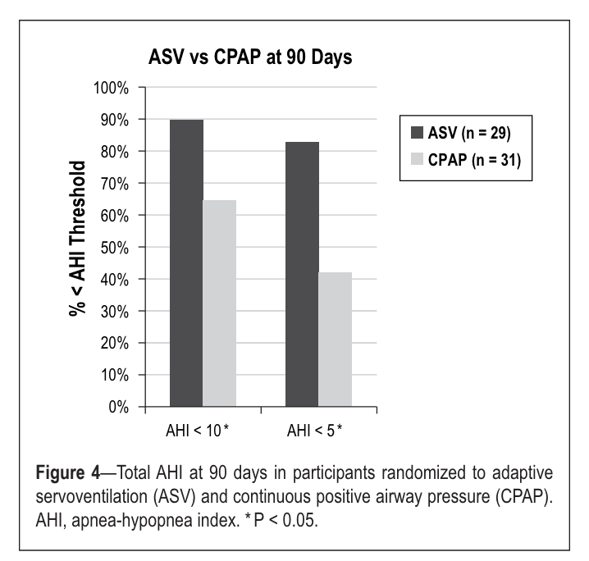
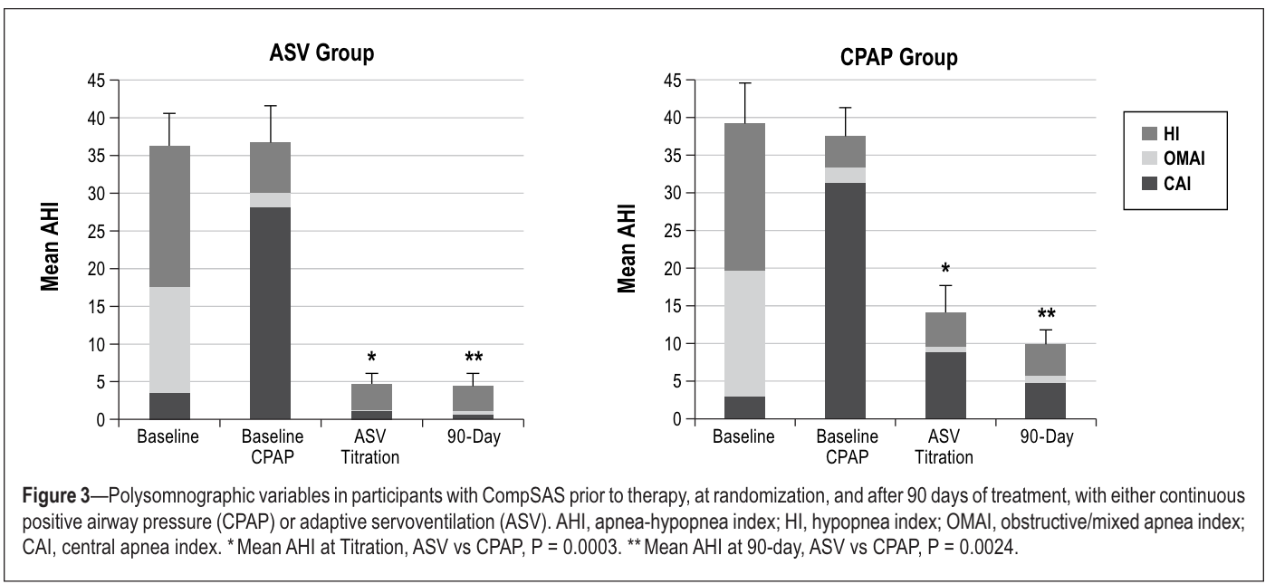
Treatment-emergent central sleep apnea
Expectant management with CPAP
Morgenthaler TI, Kuzniar TJ, Wolfe LF, Willes L, McLain WC 3rd, Goldberg R. The complex sleep apnea resolution study: a prospective randomized controlled trial of continuous positive airway pressure versus adaptive servoventilation therapy. Sleep. 2014 May 1;37(5):927-34. doi: 10.5665/sleep.3662. PMID: 24790271; PMCID: PMC3985095.

Slide 41
Treatment-emergent central sleep apnea
Alternative modes of ventilation
BiPAP with BUR
Adaptive Servo-Ventilation (ASV)
Both ASV and BPAP with a backup respiratory rate decrease the frequency of obstructive and central apnea and hypopneas, but ASV may have a slightly larger magnitude of effect. In addition, limited longer-term data suggest that re-emergence of central events may be of concern with BPAP but not ASV.

Slide 42
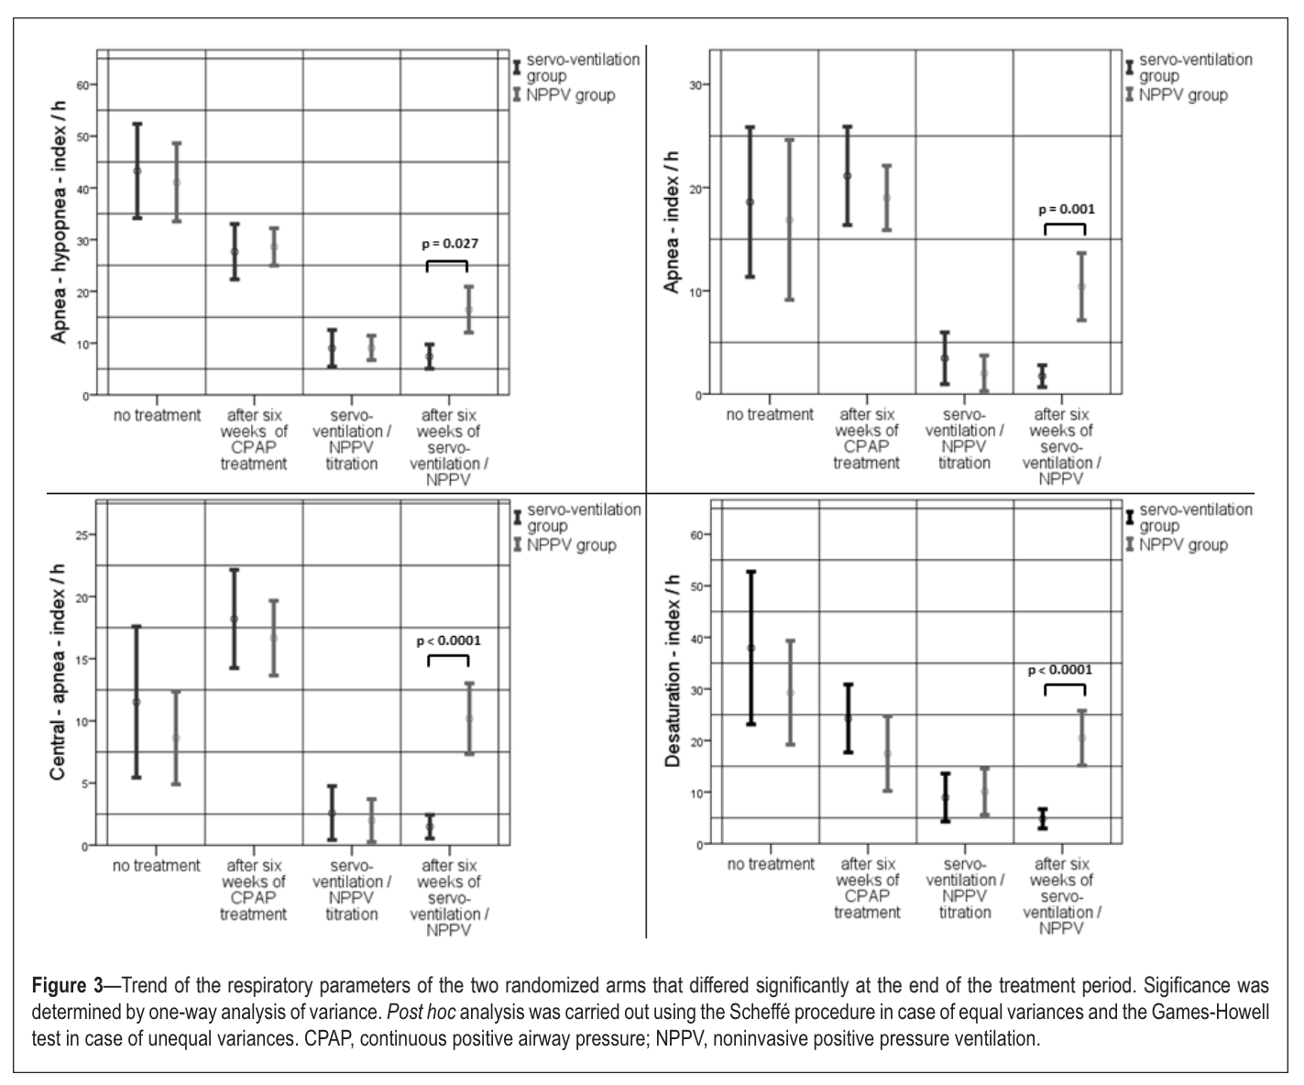
BiPAP BUR vs ASV
N=15 each
Dellweg D, Kerl J, Hoehn E, Wenzel M, Koehler D. Randomized controlled trial of noninvasive positive pressure ventilation (NPPV) versus servoventilation in patients with CPAP-induced central sleep apnea (complex sleep apnea). Sleep. 2013 Aug 1;36(8):1163-71. doi: 10.5665/sleep.2878. PMID: 23904676; PMCID: PMC3700713.

Slide 43
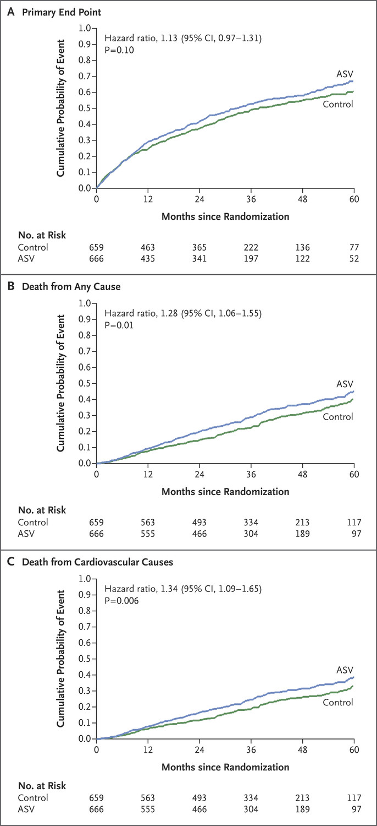
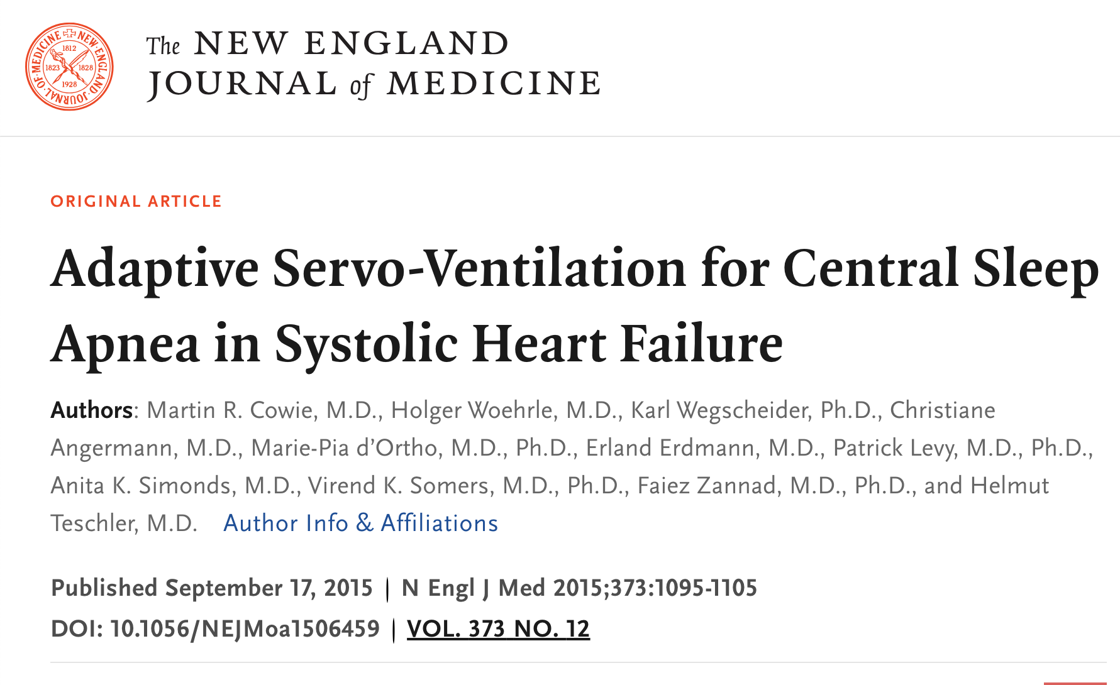
Adaptive servo-ventilation :
ASV should be avoided in patients with CSA associated with heart failure with reduced EF. This is based on results of SERVE-HF, a randomized trial of ASV versus standard medical therapy in patients with predominantly CSA due to symptomatic heart failure and a low EF (≤45 percent) in which ASV was associated with a 6 percent absolute increase in all-cause mortality and cardiovascular mortality compared with standard medical therapy .

Slide 44
Other potential therapies :
O2:
Supplemental nocturnal oxygen has been tried with some success in patients with CSA due to heart failure providing potential rationale for its use in treatment-emergent CSA.
The proposed mechanism of action is via a reduction in loop gain with resultant amelioration of CSA .However, there are no controlled trials of oxygen alone or in conjunction with PAP in patients with treatment-emergent CSA.
N= 25 in each arm
Circ J 2006; 70: 1–7

Slide 45
Modes to avoid :
In contrast to BPAP with a backup rate, BPAP without a backup rate does not decrease the AHI during BPAP compared with during the initiation of CPAP in patients with treatment-emergent CSA, and it may even worsen the AHI.

Slide 46
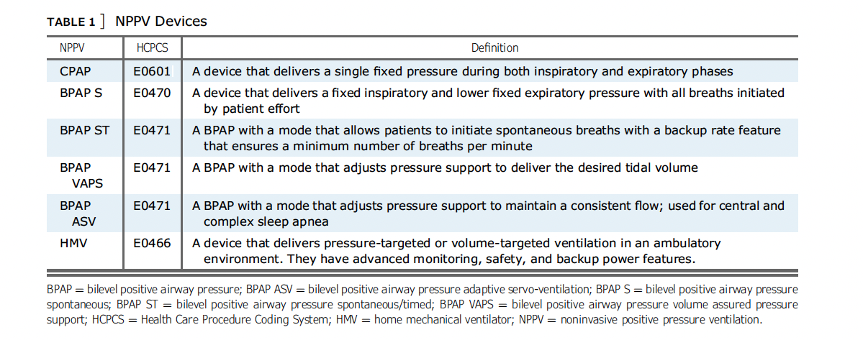
Acute on chronic hypercapnic respiratory failure (ACHRF )
characterized by an acutely elevated PaCO2, low pH, and higher than normal serum bicarbonate (HCO3) in the setting of chronic respiratory diseases such as COPD, OHS, and RTDs.
Hypercapnia occurs from alveolar hypoventilation, which could be from reduced minute ventilation or increased dead space ventilation.
NPPV is effective in the treatment of ACHRF associated with each of these chronic respiratory diseases.

Slide 47
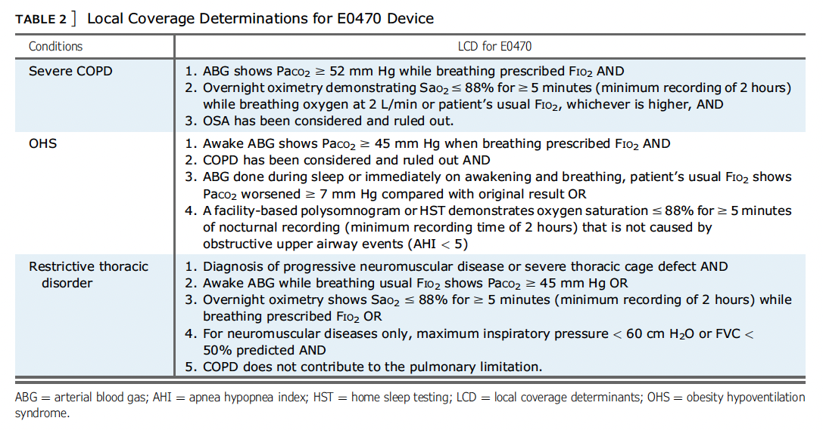
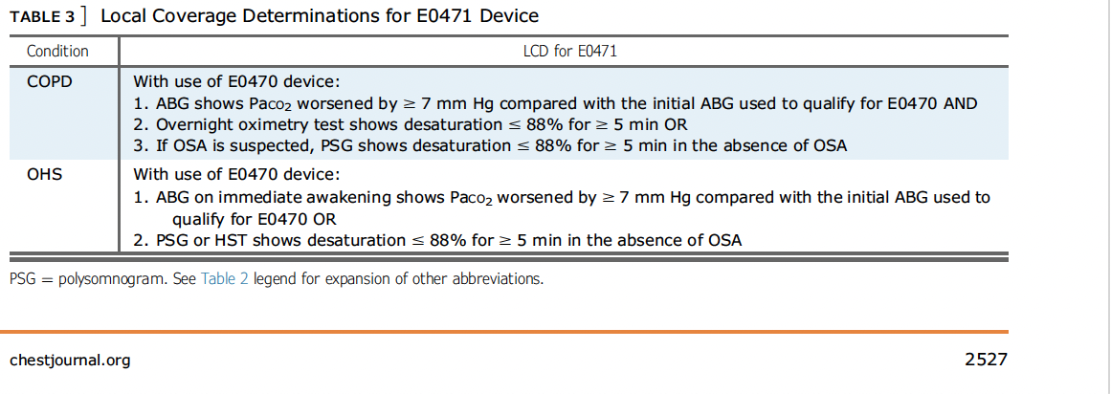
Acute on chronic hypercapnic respiratory failure (ACHRF )

Slide 48
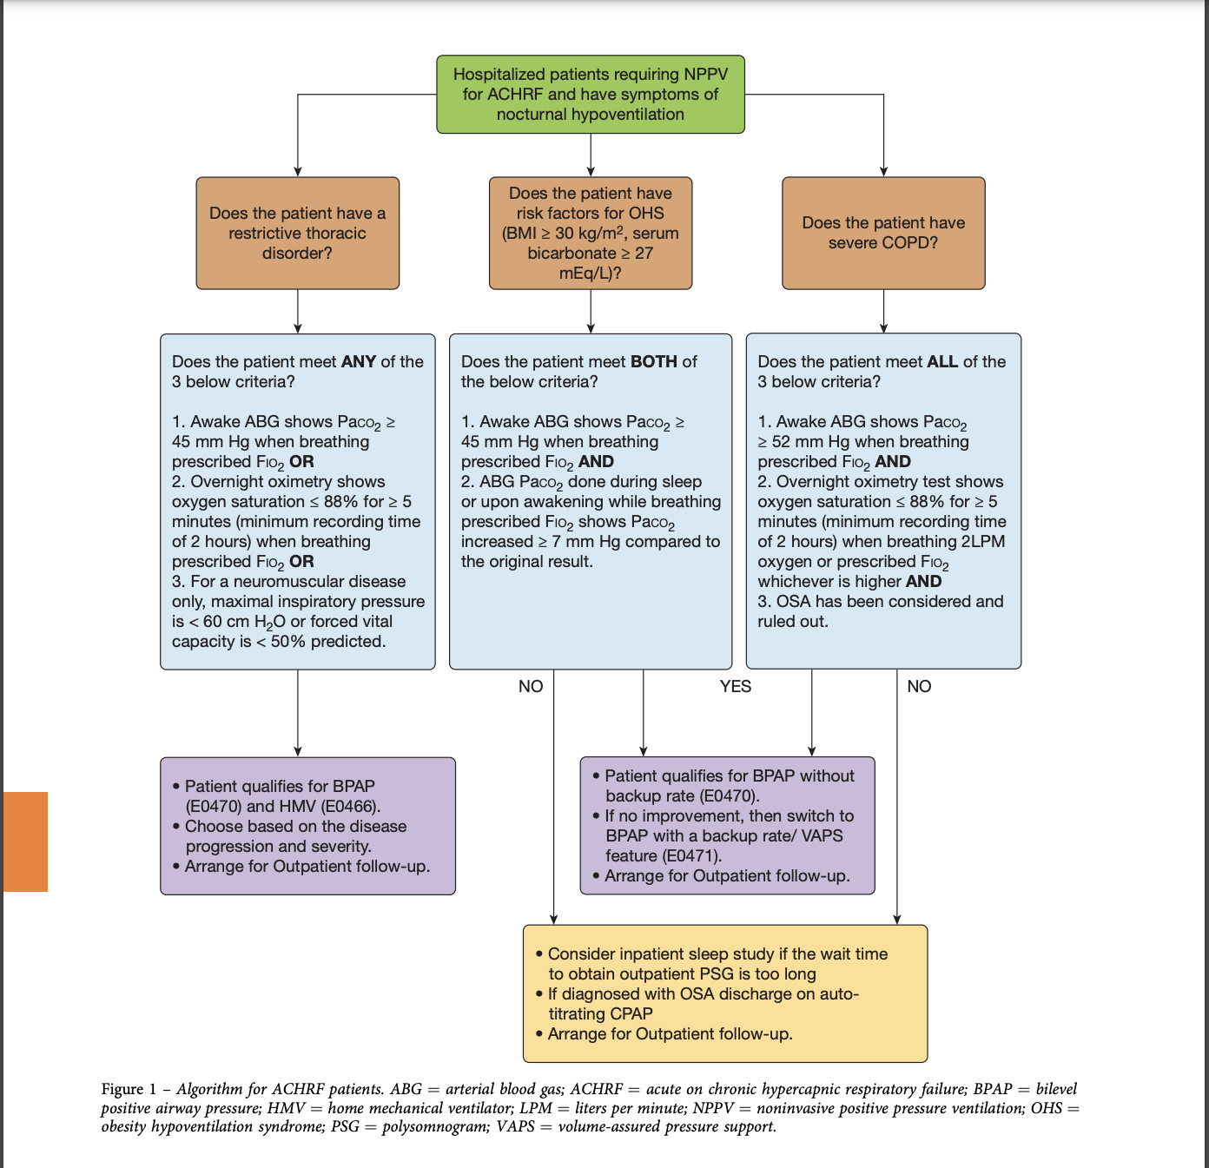

Slide 49
Thank you

