Slide 1
Motivational Interviewing: Conversations that Facilitate Adherence to Sleep Apnea Treatment
Catherine C. Loomis, PhD, CBSM, DBSM
Restorative Sleep, LLC
drloomis@restorativesleep.net
414-698-2654

Slide 2


Slide 3

Presentation Outline
What is Motivational Interviewing (MI)
History of Motivational Interviewing
Transtheoretical Model (Stages of Change)
Motivational Interviewing methods and techniques
Video example (woman with alcohol use)

Slide 4
What is Motivational Interviewing?
(William Miller, Stephen Rollnick, 1991)
A client-centered directive method for enhancing intrinsic motivation to change, by exploring and resolving ambivalence. MI helps to examine discrepancy between current behavior and client’s self-identified goals and values
Applied to many areas in healthcare
Empirical validation
(Video on Next Slide)

Slide 5


Slide 6
History of Motivational Interviewing: Addictions
Traditional approach:
  Patient has to accept diagnosis, problem
  Acceptance of personality pathology
  Therapist gives evidence of problem
  Push back is seen as denial
  Argumentation and correction
  Goals and strategies of change are prescribed by professional
Motivational Interviewing:
  Patient doesn’t need to accept label to change
  Emphasis on personal choice and responsibility
  Objective evaluation of problem
  Push back could be caused by the interaction
  Reflection
  Goals and strategies are negotiated

Slide 7
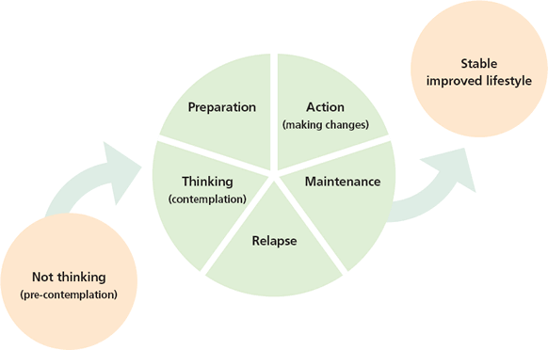
Transtheoretical Model
(James O. Prochaska, Carlos DiClemente, 1983)

Slide 8
MI Concepts and Techniques:
Sustain Talk vs Change Talk
Ambivalence
  “Using CPAP could help me to feel better, but there’s no way I would wear that mask!”
Change talk: patient speech that favors movement in the direction of change
  Includes: Desire, Ability, Reasons, Need (DARN) → commitment, taking steps
“I wish I could stop smoking (desire), because I’d have whiter teeth (reason)”
Sustain talk: is client speech that favors the status quo
“I need to lose some weight, but I hate exercising.”
“I mean to take my medication, but I keep forgetting.”
“Checking the news before bed helps me be an informed citizen.”

Slide 9
MI Concepts and Techniques:
Reflective Listening
Reflective listening involves reflecting back to the patient what they are saying and meaning
  It sounds like you…. You’re feeling…. It seems to you that…
Reflect resistance, sustain talk
  Patient: “Well, I do drink most days, but not that much really.”
  Practitioner: “You’re a pretty light drinker.”
  Patient: “Well, I’m not sure about that…”
  Patient: “I don’t believe this sleep study. I don’t think my sleep apnea is that bad.”
  Practitioner: “Your sleep apnea hasn’t caused you any problems.”
Reflect change talk

Slide 10
MI Concepts and Techniques:
Asking
Open vs closed ended questions:
“How are you doing with the CPAP? Are you using it regularly?”
“How can I be most helpful to you today?”
“Tell me more about…”
“You have had your CPAP for a month, what would it be most helpful to talk about today?”
“Why might you want to use CPAP?”
“If you did decide to make this change, how would you do it?”
“How important is it to you to make this change?”

Slide 11
MI Concepts and Techniques:
Pros and Cons (Decisional Balance)
What do you like about your smoking?
What do not like about your drinking?
What would you like about turning in your CPAP?
What do you not like about turning in your CPAP?

Slide 12
MI Concepts and Techniques:
Rulers
Rulers are rating scales that are offered to the patient to assess the person’s motivation and elicit change talk
“How important would you say it is to get your sleep apnea treated? On a scale from 1 to 10, where 1 is not at all important to 10 is extremely important.”
Can ask about confidence, importance and readiness.
“Why did you rate it a 7 and not a 5?”
“What would need to happen for it to be a 9?”
Need to be in context of good rapport

Slide 13
MI Concepts and Techniques:
Using Assessment
Personalized feedback based on the patient’s concerns
Results are offered, as opposed to given
Comparison of the patient’s scores with normative data
Use the feedback to solicit the patient’s reactions, e.g., “What do you think about this?”
Look for the patient’s non-verbal communication
Reflect and elaborate on change talk

Slide 14
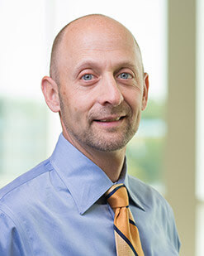
Example of Assessment in Motivational Interviewing
Mark Aloia, PhD, National Jewish Health, Denver, CO
24 sleep apnea patients
12 shown video of someone else’s sleep apnea
12 shown video of their own sleep apnea
Those who viewed themselves used CPAP for two more
hours per night than those that saw someone
else, at three months follow up

Slide 15
MI Concepts and Techniques:
What’s Next? / Summary
“So, what do you make of this now?”
“So what are you thinking about sleep apnea, now?”
“What do you think you’ll do?”
“What would be a first step for you?”
Patient hears all the accumulated arguments for change that the patient has given (change talk)
Shows you have been listening.
Catches if you have missed anything, “is there anything else?”

Slide 16
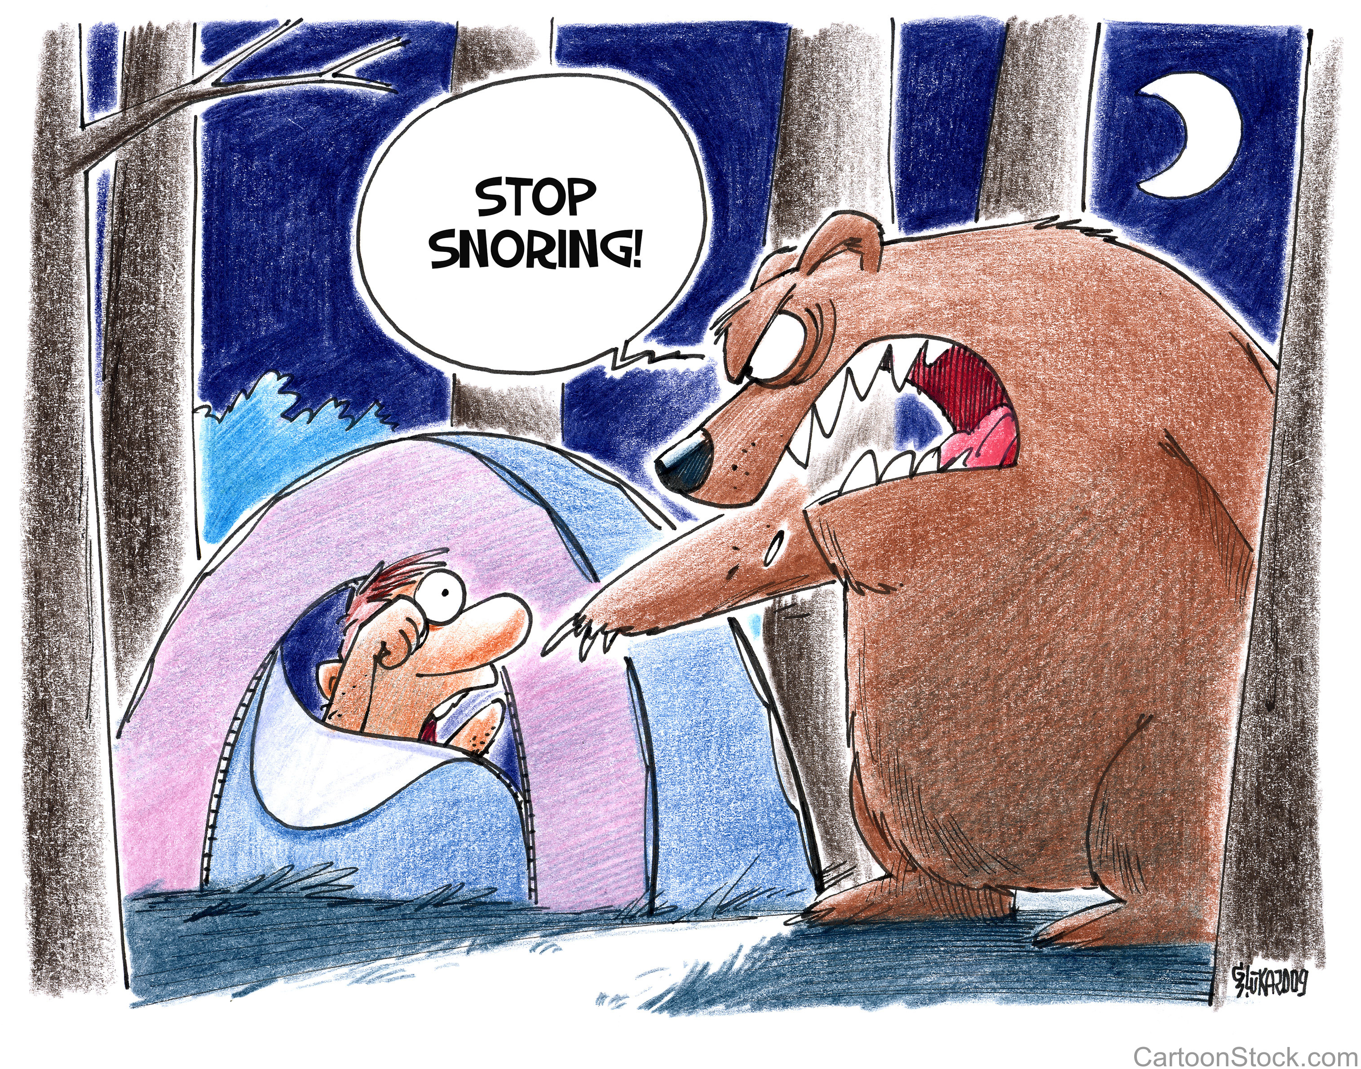
Motivational Interviewing in CPAP Adherence
Aloia, MS et al., Sleep and Breathing, 5, 2001
Aloia, MS et al, Behavioral Sleep Medicine, 2(4), 2004 (manual)
Aloia, MS, et al, Behavioral Sleep Medicine, 5(2), 2007
Olsen, S et al, Journal of Consulting and Clinical Psychology, 80(1), 2011

Slide 17
Example of Motivational Interviewing:
Alcohol Use
What principles and techniques of motivational interviewing do you see in this video?
How is the patient responding to this method of interaction?
What stage of change do you see her in?
(Video on next slide)

Slide 18


Slide 19


The End
Catherine Loomis
414-698-2654
drloomis@restorativesleep.net

